Slide 1
DECISION TREE ALGORITHM
7PAM2021-0901-2024 - Machine Learning and Neural Networks

Slide 2
AGENDA
Introduction: What is a Decision Tree?
How do Decision Trees work?
Understanding the Dataset
Building the Model
Visualizing the Decision Tree
Conclusion

Slide 3
INTRODUCTION: WHAT IS A DECISION TREE?
Decision trees are a popular and powerful tool used in various fields such as machine learning, data mining, and statistics
A versatile, interpretable algorithm used for predictive modelling
The decision tree algorithm falls under the category of supervised learning.
Used to solve both regression and classification problems
It structures decisions based on input data, making it suitable for both classification and regression tasks

Slide 4
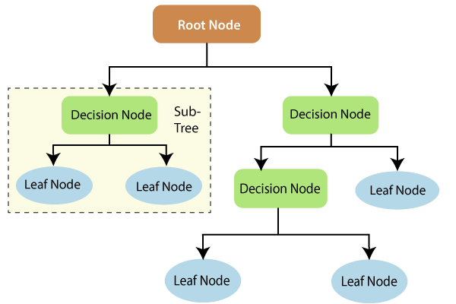
INTRODUCTION: WHAT IS A DECISION TREE?
Structure of a Decision Tree
1. Root Node
2. Internal Nodes
3. Branches
4. Leaf Nodes

Slide 5
HOW DO DECISION TREES WORK?
The process of creating a decision tree involves:
1. Selecting the Best Attribute: Using a metric like Gini impurity, entropy, or information gain, the best attribute to split the data is selected.
2. Splitting the Dataset: The dataset is split into subsets based on the selected attribute.
3. Repeating the Process: The process is repeated recursively for each subset, creating a new internal node or leaf node until a stopping criterion is met (e.g., all instances in a node belong to the same class or a predefined depth is reached).

Slide 6
HOW DO DECISION TREES WORK?
1.1 INFORMATION GAIN
Information gain is a measure of change in entropy.
Suppose S is a set of instances,
A is an attribute
Sv is the subset of S
v represents an individual value that the attribute A can take and Values (A) is the set of all possible values of A, then

Slide 7
HOW DO DECISION TREES WORK?
ENTROPY: is the measure of uncertainty of a random variable, it characterizes the impurity of an arbitrary collection of examples. The higher the entropy more the information content.
Example:
For the set X = {a,a,a,b,b,b,b,b}
Total instances: 8
Instances of b : 5
Instances of a : 3
Entropy H(X)=[(8/3)log(8/3) + (8/5)log (8/5)​]
=−[0.375(−1.415)+0.625(−0.678)]
=−(−0.53−0.424)
=0.954
​

Slide 8
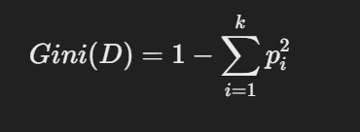
HOW DO DECISION TREES WORK?
k = number of unique classes in the dataset
pip_ipi​ = proportion of samples belonging to class iii in dataset DDD
1.2 GINI INDEX
Gini Index is a metric to measure how often a randomly chosen element would be incorrectly identified.
Sklearn supports “Gini” criteria for Gini Index and by default, it takes “gini” value.
The Formula for Gini Index is given by :
It ranges from 0 to 0.5, where 0 indicates a pure set (all instances belong to the same class), and 0.5 indicates a maximally impure set (instances are evenly distributed across classes).
k = number of unique classes in the dataset
Pi = proportion of samples belonging to class 𝑖

Slide 9
UNDERSTANDING THE DATASET
Dataset Name: Iris Dataset
One of the most famous datasets in machine learning and statistics.
2. Source:
Collected by British statistician and biologist Ronald Fisher in 1936.
3. Dataset Description
Contains data about 150 samples of iris flowers from three species:
Setosa
Versicolor
Virginica
4. Features:
Each sample has 4 numerical features (in cm):
Sepal Length 3. Petal Length
Sepal Width 4. Petal Width
Petal Length
Petal Width

Slide 10
UNDERSTANDING THE DATASET
5. Target Variable:
Species: Categorical variable with three classes corresponding to the flower species.
Let’s have a look at the code now!

Slide 11
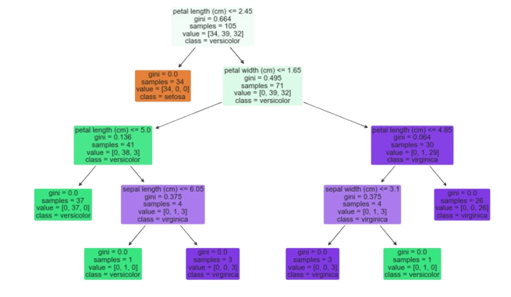
VISUALIZING THE DECISION TREE

Slide 12
CONCLUSION
Decision trees are powerful and interpretable models that can be used for both classification and regression tasks.
The decision tree effectively classifies the Iris dataset, achieving pure nodes (gini = 0) in many cases.
This visualization highlights the hierarchical decision-making process, with simple conditions leading to accurate classifications.

Slide 13
Thank You!

